Slide 1

Course : Data Structures
Subject Code : CSEN2001 Program : B. Tech
Year : II
Dept. and Sec : CSE ( )
UNIT : III
Dr Kranthi Kumar Singamaneni
Dept. of C.S.E
G.S.T, GITAM Deemed to be University

Slide 2
Stacks:
Definitions
Operations
Applications
Array representation of stacks
Linked list representation of stacks
Queues:
Definitions
Operations
array and representation of queues
Linked list representation of queues
Types of Queues

Slide 3
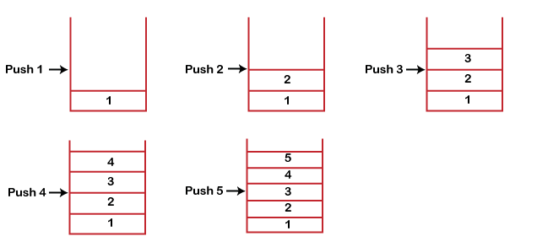
What is a Stack?
A Stack is a linear data structure that follows the LIFO (Last-In-First-Out) principle. The stack has one end, whereas the Queue has two ends (front and rear).
It contains only one pointer top pointer pointing to the topmost element of the stack. Whenever an element is added in the stack, it is added on the top of the stack, and the element can be deleted only from the stack.
In other words, a stack can be defined as a container in which insertion and deletion can be done from one end known as the top of the stack.
Some key points related to stack
It is called a stack because it behaves like a real-world stack, piles of books, etc.
A Stack is an abstract data type with a pre-defined capacity, which means that it can store elements of a limited size.
It is a data structure that follows some order to insert and delete the elements, and that order can be LIFO or FILO.
Working of Stack: Stack works on the LIFO pattern. As we can observe below figure there are five memory blocks in the stack; therefore, the size of the stack is 5.
Suppose we want to store the elements in a stack and let's assume that stack is empty. We have taken the stack of size 5 as shown below in which we are pushing the elements one by one until the stack becomes full.
Since our stack is full as the size of the stack is 5. In the above cases, we can observe that it goes from the top to the bottom when we were entering the new element in the stack. The stack gets filled up from the bottom to the top.
When we perform the delete operation on the stack, there is only one way for entry and exit as the other end is closed. It follows the LIFO pattern, which means that the value entered first will be removed last. In the above case, the value 5 is entered first, so it will be removed only after the deletion of all the other elements.

Slide 4
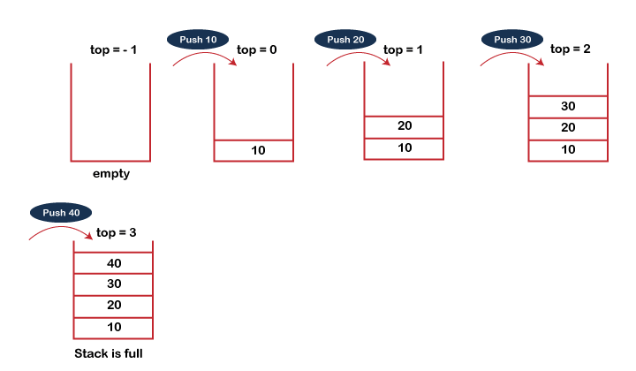
Standard Stack Operations:
The following are some common operations implemented on the stack:
push(): When we insert an element in a stack then the operation is known as a push. If the stack is full then the overflow condition occurs.
pop(): When we delete an element from the stack, the operation is known as a pop. If the stack is empty means that no element exists in the stack, this state is known as an underflow state.
isEmpty(): It determines whether the stack is empty or not.
isFull(): It determines whether the stack is full or not.'
peek(): It returns the element at the given position.
count(): It returns the total number of elements available in a stack.
change(): It changes the element at the given position.
display(): It prints all the elements available in the stack.
PUSH operation: The steps involved in the PUSH operation is given below:
Before inserting an element in a stack, we check whether the stack is full.
If we try to insert the element in a stack, and the stack is full, then the overflow condition occurs.
When we initialize a stack, we set the value of top as -1 to check that the stack is empty.
When the new element is pushed in a stack, first, the value of the top gets incremented, i.e., top=top+1, and the element will be placed at the new position of the top.
The elements will be inserted until we reach the max size of the stack.

Slide 5
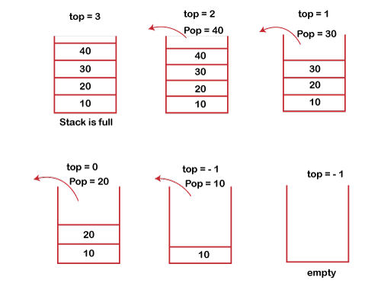
POP operation: The steps involved in the POP operation is given below:
Before deleting the element from the stack, we check whether the stack is empty.
If we try to delete the element from the empty stack, then the underflow condition occurs.
If the stack is not empty, we first access the element which is pointed by the top
Once the pop operation is performed, the top is decremented by 1, i.e., top=top-1.

Slide 6
Applications of Stack: The following are the applications of the stack:
Balancing of symbols: A stack is used for balancing a symbol. As we know, each program has opening and closing braces; when the opening braces come, we push the braces in a stack, and when the closing braces appear, we pop the opening braces from the stack. Therefore, the net value comes out to be zero. If any symbol is left in the stack, it means that some syntax occurs in a program.
String reversal: A stack is also used for reversing a string. For example, we want to reverse a “Computer" string, so we can achieve this with the help of a stack. First, we push all the characters of the string in a stack until we reach the null character. After pushing all the characters, we start taking out the character one by one until we reach the bottom of the stack.
UNDO/REDO: It can also be used for performing UNDO/REDO operations. For example, we have an editor in which we write 'a', then 'b', and then 'c'; therefore, the text written in an editor is abc. So, there are three states, a, ab, and abc, which are stored in a stack. There would be two stacks in which one stack shows UNDO state, and the other the shows REDO state. If we want to perform UNDO operation, and want to achieve 'ab' state, then we implement the pop operation
Recursion: The recursion means that the function is calling itself again. To maintain the previous states, the compiler creates a system stack in which all the previous records of the function are maintained.
DFS(Depth First Search): This search is implemented on a Graph, and Graph uses the stack data structure.
Backtracking: Suppose we have to create a path to solve a maze problem. If we are moving in a particular path, and we realize that we come on the wrong way. In order to come at the beginning of the path to create a new path, we have to use the stack data structure.
Expression conversion: Stack can also be used for expression conversion. This is one of the most important applications of stack. The list of the expression conversion is given below: 1. Infix to prefix 2. Infix to postfix 3. Prefix to infix 4. Prefix to postfix 5. Postfix to infix
Memory management: The stack manages the memory. The memory is assigned in the contiguous memory blocks. The memory is known as stack memory as all the variables are assigned in a function call stack memory. The memory size assigned to the program is known to the compiler. When the function is created, all its variables are assigned in the stack memory. When the function completed its execution, all the variables assigned in the stack are released.

Slide 7
#include <stdio.h>
int stack[100], i, j, choice=0, n, top=-1;
void push();
void pop();
void show();
void main ()
{
printf("Enter the number of elements in the stack ");
scanf("%d",&n);
printf("Stack operations using array");
while(choice != 4)
{
printf("Chose one from the below options...\n");
printf("\n1.Push\n2.Pop\n3.Show\n4.Exit");
printf("\n Enter your choice \n");
scanf("%d",&choice);
switch(choice)
{
case 1: push(); break;
case 2: pop(); break;
case 3: show(); break;
case 4: printf("Exiting...."); break;
default: printf("Please Enter valid choice ");
}
}
}
void push ()
{
int val;
if (top == n ) printf("\n Overflow");
else
{
printf("Enter the value?");
scanf("%d",&val);
top = top +1;
stack[top] = val;
}
}
void pop ()
{
if(top == -1) printf("Underflow");
else
top = top -1;
}
void show()
{
for (i=top;i>=0;i--)
{
printf("%d\n",stack[i]);
}
if(top == -1)
{
printf("Stack is empty");
}
}

Slide 8
/* * C Program to Implement a Stack using Linked List */
#include <stdio.h> #include <stdlib.h>
struct node { int info; struct node *ptr; }*top,*top1,*temp;
int topelement(); void push(int data); void pop(); void empty();
void display(); void destroy(); void stack_count(); void create();
int count = 0;
void main()
{
int no, ch, e;
printf("\n 1 - Push"); printf("\n 2 - Pop"); printf("\n 3 - Top"); printf("\n 4 - Empty"); printf("\n 5 - Exit"); printf("\n 6 - Dipslay"); printf("\n 7 - Stack Count"); printf("\n 8 - Destroy stack");
create();
while (1)
{
printf("\n Enter choice : "); scanf("%d", &ch);
switch (ch)
{
case 1: printf("Enter data : "); scanf("%d", &no); push(no); break;
case 2: pop(); break;
case 3: if (top == NULL) printf("No elements in stack");
else { e = topelement(); printf("\n Top element : %d", e); } break;
case 4: empty(); break; case 5: exit(0); case 6: display(); break;
case 7: stack_count(); break; case 8: destroy(); break;
default : printf(" Wrong choice, Please enter correct choice "); break; } } }
/* Create empty stack */ void create() { top = NULL; }
/* Count stack elements */ void stack_count()
{ printf("\n No. of elements in stack : %d", count); }
/* Push data into stack */ void push(int data) {
if (top == NULL) { top =(struct node *)malloc(1*sizeof(struct node)); top->ptr = NULL; top->info = data; } else { temp =(struct node *)malloc(1*sizeof(struct node)); temp->ptr = top; temp->info = data; top = temp; } count++; }
/* Display stack elements */ void display()
{ top1 = top; if (top1 == NULL)
{ printf("Stack is empty"); return; }
while (top1 != NULL) { printf("%d ", top1->info);
top1 = top1->ptr; } }
/* Pop Operation on stack */ void pop() { top1 = top;
if (top1 == NULL)
{ printf("\n Error : Trying to pop from empty stack"); return; }
else top1 = top1->ptr;
printf("\n Popped value : %d", top->info); free(top);
top = top1; count--; } /* Return top element */ int topelement() { return(top->info); }
/* Check if stack is empty or not */ void empty() {
if (top == NULL) printf("\n Stack is empty"); else printf("\n Stack is not empty with %d elements", count); }
/* Destroy entire stack */ void destroy()
{ top1 = top;
while (top1 != NULL) { top1 = top->ptr; free(top);
top = top1; top1 = top1->ptr; }
free(top1); top = NULL;
printf("\n All stack elements destroyed"); count = 0; }

Slide 9
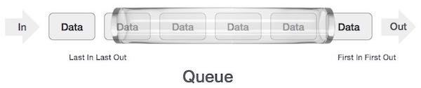

What is Queue? : A queue is defined as a linear data structure that is open at both ends and the operations are performed in First In First Out (FIFO) order. We define a queue to be a list in which all additions to the list are made at one end, and all deletions from the list are made at the other end. The element which is first pushed into the order, the operation is first performed on that.
A queue is an abstract data structure, somewhat similar to Stacks. Unlike stacks, a queue is open at both ends. One end is always used to insert data (enqueue) and the other is used to remove data (dequeue). Queue follows the First-In-First-Out methodology, i.e., the data item stored first will be accessed first.
As in stacks, a queue can also be implemented using Arrays, Linked-lists, Pointers, and Structures.
A real-world example of a queue can be a single-lane one-way road, where the vehicle enters first, and exits first. More real-world examples can be seen as queues at the ticket windows and bus stops.
Queue Representation: As we now understand that in the queue, we access both ends for different reasons. The following diagram given below tries to explain queue representation as a data structure −
Basic Operations: Queue operations may involve initializing or defining the queue, utilizing it, and then completely erasing it from the memory.
enqueue() − add (store) an item to the queue.
dequeue() − remove (access) an item from the queue.
Few more functions are required to make the above-mentioned queue operation efficient. These are −
peek() − Gets the element at the front of the queue without removing it.
isfull() − Checks if the queue is full.
isempty() − Checks if the queue is empty.
In the queue, we always dequeue (or access) data, pointed by the front pointer, and while enqueuing (or storing) data in the queue we take the help of the rear pointer.

Slide 10
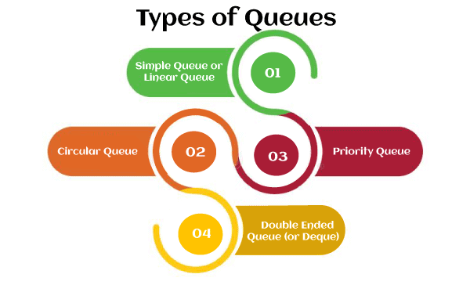
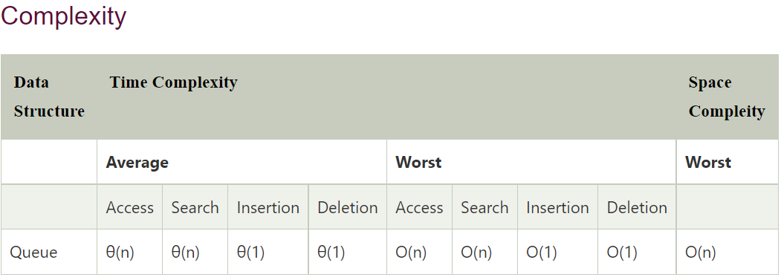
Applications of Queue: Due to the fact that queue performs actions on a first in first out basis which is quite fair for the ordering of actions. There are various applications of queues discussed below.
Queues are widely used as waiting lists for a single shared resource like a printer, disk, or CPU.
Queues are used in the asynchronous transfer of data (where data is not being transferred at the same rate between two processes) eg. pipes, file IO, and sockets.
Queues are used as buffers in most of the applications like MP3 media players, CD players, etc.
Queues are used to maintain the playlist in media players in order to add and remove the songs from the playlist.
Queues are used in operating systems for handling interrupts.
Types of Queue: There are four different types of queues that are listed as follows –
Simple Queue or Linear Queue (discussed already)
Circular Queue
Priority Queue
Double Ended Queue (or Deque)
The major drawback of using a linear Queue is that insertion is done only from the rear end. If the first three elements are deleted from the Queue, we cannot insert more elements even though the space is available in a Linear Queue.
In this case, the linear Queue shows the overflow condition as the rear is pointing to the last element of the Queue.

Slide 11
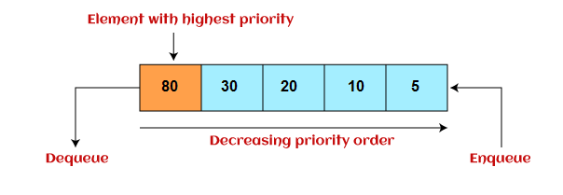
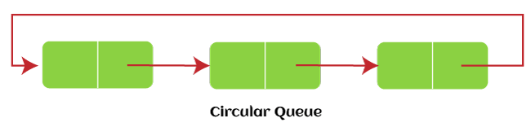
Circular Queue: In Circular Queue, all the nodes are represented as circular. It is similar to the linear Queue except that the last element of the queue is connected to the first element. It is also known as Ring Buffer, as all the ends are connected to another end. The representation of the circular queue is shown in the below image –
The drawback that occurs in a linear queue is overcome by using the circular queue. If the empty space is available in a circular queue, the new element can be added in an empty space by simply incrementing the value of rear. The main advantage of using the circular queue is better memory utilization.
Priority Queue
It is a special type of queue in which the elements are arranged based on priority. It is a special type of queue data structure in which every element has a priority associated with it. Suppose some elements occur with the same priority, they will be arranged according to the FIFO principle. The representation of the priority queue is shown in the below image –
Insertion in the priority queue takes place based on the arrival, while deletion in the priority queue occurs based on the priority. A priority queue is mainly used to implement the CPU scheduling algorithms. There are two types of priority queues that are discussed as follows –
Ascending priority queue - In ascending priority queue, elements can be inserted in arbitrary order, but only the smallest can be deleted first. Suppose an array with elements 7, 5, and 3 in the same order, so, insertion can be done with the same sequence, but the order of deleting the elements is 3, 5, 7.
Descending priority queue - In descending priority queue, elements can be inserted in arbitrary order, but only the largest element can be deleted first. Suppose an array with elements 7, 3, and 5 in the same order, so, insertion can be done with the same sequence, but the order of deleting the elements is 7, 5, 3.

Slide 12
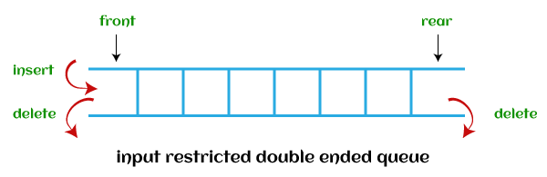
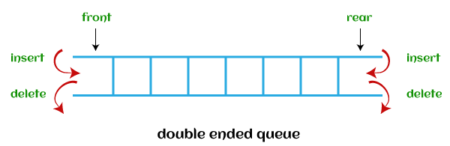
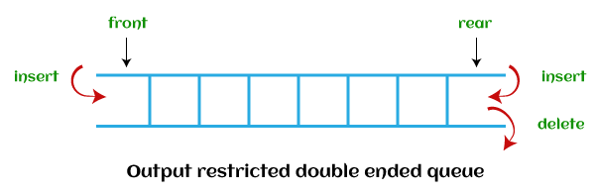
Deque (or, Double Ended Queue):
In Deque or Double Ended Queue, insertion and deletion can be done from both ends of the queue either from the front or rear. It means that we can insert and delete elements from both front and rear ends of the queue. Deque can be used as a palindrome checker means that if we read the string from both ends, then the string would be the same.
Deque can be used both as stack and queue as it allows the insertion and deletion operations on both ends. Deque can be considered as stack because stack follows the LIFO (Last In First Out) principle in which insertion and deletion both can be performed only from one end. And in deque, it is possible to perform both insertion and deletion from one end, and Deque does not follow the FIFO principle.
The representation of the deque is shown in the below image -
here are two types of deque that are discussed as follows –
Input restricted deque - As the name implies, in input restricted queue, insertion operation can be performed at only one end, while deletion can be performed from both ends.
Output restricted deque - As the name implies, in output restricted queue, deletion operation can be performed at only one end, while insertion can be performed from both ends.

Slide 13
Simple Queue or Linear Queue C Code
#include <stdio.h>
#define MAX 50
void insert();
void delete();
void display();
int queue_array[MAX];
int rear = - 1; int front = - 1;
int main()
{
int choice;
while (1)
{
printf("1.Insert element to queue \n");
printf("2.Delete element from queue \n");
printf("3.Display all elements of queue \n");
printf("4.Quit n");
printf("Enter your choice : ");
scanf("%d", &choice);
switch(choice)
{
case 1: insert(); break;
case 2: delete(); break;
case 3: display(); break;
case 4: exit(1);
default: printf("Wrong choice \n");
}
}
}
void insert()
{
int item;
if(rear == MAX - 1)
printf("Queue Overflow \n");
else
{
if(front== - 1)
front = 0;
printf("Insert the element in queue : ");
scanf("%d", &item);
rear = rear + 1;
queue_array[rear] = item;
}
}
void delete()
{
if(front == - 1 || front > rear)
{
printf("Queue Underflow \n");
return;
}
else
{
printf(" Deleted Element is : %d \n", queue_array[front]);
front = front + 1;
}
}
void display()
{
int i;
if(front == - 1)
printf("Queue is empty \n");
else
{
printf("Queue is : \n");
for(i = front; i <= rear; i++)
printf("%d ", queue_array[i]);
printf("n");
}
}

Slide 14
/* * C Program to Implement Queue Data Structure using Linked List */ #include <stdio.h> #include <stdlib.h> struct node { int info; struct node *ptr; }*front,*rear,*temp,*front1; int frontelement(); void enq(int data); void deq(); void empty(); void display(); void create(); void queuesize(); int count = 0; void main() { int no, ch, e; printf("\n 1 - Enque"); printf("\n 2 - Deque"); printf("\n 3 - Front element"); printf("\n 4 - Empty"); printf("\n 5 - Exit"); printf("\n 6 - Display"); printf("\n 7 - Queue size"); create(); while (1) { printf("\n Enter choice : "); scanf("%d", &ch); switch (ch) { case 1: printf("Enter data : "); scanf("%d", &no); enq(no); break; case 2: deq(); break; case 3: e = frontelement(); if (e != 0) printf("Front element : %d", e); else printf("\n No front element in Queue as queue is empty"); break; case 4: empty(); break; case 5: exit(0); case 6: display(); break; case 7: queuesize(); break; default: printf("Wrong choice, Please enter correct choice "); break; } } } /* Create an empty queue */ void create() { front = rear = NULL; } /* Returns queue size */ void queuesize() { printf("\n Queue size : %d", count); } /* Enqueing the queue */ void enq(int data) { if (rear == NULL) { rear = (struct node *)malloc(1*sizeof(struct node)); rear->ptr = NULL; rear->info = data; front = rear; } else { temp=(struct node *)malloc(1*sizeof(struct node)); rear->ptr = temp; temp->info = data; temp->ptr = NULL; rear = temp; } count++; } /* Displaying the queue elements */ void display() { front1 = front; if ((front1 == NULL) && (rear == NULL)) { printf("Queue is empty"); return; } while (front1 != rear) { printf("%d ", front1->info); front1 = front1->ptr; } if (front1 == rear) printf("%d", front1->info); } /* Dequeing the queue */ void deq() { front1 = front; if (front1 == NULL) { printf("\n Error: Trying to display elements from empty queue"); return; } else if (front1->ptr != NULL) { front1 = front1->ptr; printf("\n Dequed value : %d", front->info); free(front); front = front1; } else { printf("\n Dequed value : %d", front->info); free(front); front = NULL; rear = NULL; } count--; } /* Returns the front element of queue */ int frontelement() { if ((front != NULL) && (rear != NULL)) return(front->info); else return 0; } /* Display if queue is empty or not */ void empty() { if ((front == NULL) && (rear == NULL)) printf("\n Queue empty"); else printf("Queue not empty"); }

Slide 15
Stacks applications: Perform string reversal using stack
void pop()
{
// Pop (Removing element from stack)
printf("%c",stack[top--]);
}
main()
{
char str[100]; int len,i;
clrscr();
printf("Enter a string");
gets(str);
len = strlen(str);
for(i=0;i<len;i++)
push(str[i]);
for(i=0;i<len;i++)
pop();
getch();
return 0;
}
#include <stdio.h>
#include <string.h>
#define max 100
int top, stack[max];
void push(char x)
{
// Push(Inserting Element in stack) operation
if(top == max-1)
{
printf("stack overflow");
}
else
{
stack[++top]=x;
}
}

Slide 16
Stacks applications: Conversion of Infix to Postfix Expression using Stack
To convert the Infix expression to the Postfix expression, we will use the stack data structure. By scanning the infix expression from left to right, if we get any operand, simply add it to the postfix form, and for the operator and parenthesis, add them in the stack maintaining their precedence of them.
Infix Expression: Infix Expression contains an operator in-between every pair of operands, Expression of the form a op b.
Postfix expression: Postfix Expression contains an operator followed for every pair of operands, Expression of the form a b op.
Why postfix representation of the expression?
Infix expressions are readable and solvable by humans because of the easily distinguishable order of operators, but the compiler doesn’t have an integrated order of operators.
Hence to solve the Infix Expression compiler will scan the expression multiple times to solve the sub-expressions in expressions orderly which is very inefficient.
To avoid this traversing, Infix expressions are converted to Postfix expressions before evaluation.
Algorithm
Step 1: Scan the Infix Expression from left to right.
Step 2: If the scanned character is an operand, append it with the final Infix to the Postfix string.
Step 3 Else,
Step 3.1: If the precedence order of the scanned(incoming) operator is greater than the precedence order of the operator in the stack (or the stack is empty or the stack contains a ‘(‘ or ‘[‘ or ‘{‘), push it on the stack.
Step 3.2: Else, Pop all the operators from the stack which are greater than or equal to in precedence than that of the scanned operator. After doing that Push the scanned operator to the stack. (If you encounter parenthesis while popping then stop there and push the scanned operator in the stack.)
Step 4: If the scanned character is an ‘(‘ or ‘[‘ or ‘{‘, push it to the stack.
Step 5: If the scanned character is an ‘)’ or ‘]’ or ‘}’, pop the stack and output it until a ‘(‘ or ‘[‘ or ‘{‘ respectively is encountered, and discard both the parenthesis.
Step 6: Repeat steps 2-6 until the infix expression is scanned.
Step 7: Print the output
Step 8: Pop and output from the stack until it is not empty.

Slide 17
Evaluation of Arithmetic Expression
Types of Expression Evaluation in C: There are four types of expression evaluation in the C programming language:
Evaluation of Arithmetic Expressions - Arithmetic expressions return numeric values. For example: 30 / 630/6.
Evaluation of Relational Expressions - Relational expressions is used to compare two operands. For example: (a + b) >= (c * d)(a+b)>=(c∗d).
Evaluation of Logical Expressions - Logical expressions return either true or false values. For example: (a < b) || (c == d)(a<b)∣∣(c==d).
Evaluation of Conditional Expressions - If a conditional expression is true, it returns a particular statement/expression. But if it is false, it returns another statement/expression.
For example: (10 > 3)? "expression is true" : "expression is false". In this example, since 10 > 3 is true, the statement "* expression is true" will be returned. Had it not been true, the statement "expression is false" would have been printed.
Arithmetic expressions can be written in 3 different notations - infix, prefix, and postfix. In the Prefix notation, the operator is written before the operand in an expression. On the other hand, in the Postfix notation, the operator is written after the operand. The expressions are evaluated using stack.
An expression that only contains arithmetic operands and operators is called an arithmetic expression. The results of these expressions are always in numeric values. Arithmetic expressions are usually represented in something known as the Infix Notation. In this notation, the operator is between two operands (Example: X + Y where X and Y are arithmetic operands). We can even use parentheses in arithmetic expressions.
Any arithmetic expression is written in the infix notation is evaluated by following operator precedence rules. However, if we want to evaluate an expression without considering operator precedence, we can use Polish (or Prefix) notations or Reverse Polish (or Postfix) notations.

Slide 18
The Order of Evaluation For Arithmetic Expressions: To evaluate arithmetic expressions, the compiler has a pre-defined order in which it evaluates any expression. The order of evaluation followed by the compiler is:
The expressions with parentheses are evaluated first. If two or more parentheses exist in an expression, the parentheses are evaluated from left to right. In the case of nested parentheses, the innermost parentheses are evaluated first, while the outermost one is evaluated last.
If there are no parentheses, the order of evaluation of an expression is based on the operator precedence and associativity:
Suppose parentheses do not specify the sequence of execution of an expression, and two or more operators have the same precedence. In that case, the order of evaluation is from left to right.
Suppose parentheses do not specify the sequence of execution of an expression, and two or more operators have the same precedence. In that case, the order of evaluation is from left to right.
Let us understand this topic with an example of the infix notation:
8 * sqrt(25) - -3
Steps to evaluate the above expression:
In the above expression, unary minus has the highest precedence.
So, it will be solved first. The expression will simplify to: 8 * sqrt(25) + 3.
Since sqrt(25) is a built-in function, it will be evaluated next. The expression will now become: 8 * 5 + 3.
Next, multiplication will be performed. The expression will become 40 + 3.
Finally, the addition will be performed. So, the answer will be 43.
Precedence Operator Associativity
1 Unary plus, Unary minus Left to Right
1 Built-in functions Left to Right
2 Multiplication and Division Left to Right
3 Addition and Subtraction Left to Right

Slide 19
Let us take another example:
7 * (5 + 15) / (2 * 5) - 3;
Steps to evaluate the above expression: Parentheses have the highest precedence.
So, the expressions inside the parentheses will be evaluated first.
After solving, the whole expression simplifies to: 7 * 20 / 10 – 3.
Now, multiplication and division have the same precedence.
Since multiplication and division have associativity from left to right, multiplication will be performed first.
The expression now becomes 140 / 10 - 3140/10−3.
Next, the division has higher precedence. So, the expression will become 14 - 314−3.
Finally, we will subtract 3 from 14 to get 11 as the output.

Slide 20




Polish (or Prefix) Notation: In the Polish or Prefix notation, the operator is written before the operand in an expression. This notation does not need parenthesis because the expression's evaluation is done in a stack. So, we do not need to specify the execution order to evaluate arithmetic expressions. The compiler can process the prefix notation faster than the infix notation because it does not need to process any parentheses or follow precedence rules. An expression in the Polish notation looks like this:
Let us now take an example to understand how arithmetic expressions are evaluated using the prefix notation.
* / + 9 7 8 2
Using the steps discussed above, we will calculate the value of this expression.
Step 1: Place a pointer at the last element, i.e., 2 in this example.
Step 2: Since 2 is an operand, we will push it to the stack. The stack will look like this:
* X Y
The above expression is equivalent to X * Y in the infix notation where X and Y are two arithmetic operands and * is the operator.
The steps for evaluating a prefix expression differ from the steps we commonly perform to evaluate the infix expression. We can calculate the value of the arithmetic operations by using a stack. Here are the steps to evaluate the value of a prefix expression:
Place a variable var at the last element of the expression.
If the variable var points to:
An operand, push that element to the stack.
An operator X, pop two elements (operands) from the stack and operate on the popped operands using the operator X. Once the operation is performed, push the calculated value back to the stack.
Decrement the variable's value by 1.
Repeat steps 2 and 3 until all the elements have been traversed.
Return the only value present in the stack at the end.
Step 3: We now decrease the pointer's value by 1 so that it points to the last number, which is 8. Once again, 8 is an operand, so we push it to the stack. Similarly, these steps will be repeated until the stack looks like this:
Step 4: Reducing the value of the pointer by 1 yet again, we will encounter an operator i.e., +. So, we will remove the top two elements from the stack (9 and 7) and add them. 16 (9 + 7) will be added to the stack. The stack now looks like this:
Step 5: Once again, decrease the value of the pointer and repeat the steps. Finally, after completing all calculations, we will get:
Step 6: Return the value present in the stack to get the final answer. Hence, the answer is 4.

Slide 21






Reverse Polish (or Postfix) Notation: In the Reverse Polish or Postfix notation, the operator is written after the operand in the expression. There is no need for parenthesis in this notation because the expression's order of execution is already defined in the stack. An expression in postfix notation looks like this:
Step 3: Now, increase the value of the pointer by 1. The pointer will now point at the second element, 3. Again, because 3 is an operand, push it to the stack. The stack now contains - [5 3] (bottom to top).
X Y +
Step 4: Repeat the process in Step 3. The stack now contains - [5 3 7]
The above expression is equivalent to X + Y, where X and Y are two arithmetic operands, and + is the operator. The evaluation of arithmetic expressions in postfix notation is similar to the evaluation of arithmetic expressions in prefix notation. We can also calculate the value of the arithmetic operations by using a stack. Here are the steps to evaluate the value of a postfix expression:
Place a pointer at the first element of the string.
If the pointer points to:
An operator X, pop the top two elements (operands) from the stack and operate using the operator X.
An operand, push that element to the stack.
Increase the value of the pointer by 1.
Go to step 2 if elements are left to be scanned in the expression.
Return the result stored in the stack.
Step 5: Increase the value of the pointer once again. The pointer now points at the operator *. So, take out the top two operands from the stack (7, 3) and perform a multiplication operation on them. Then, push the calculated value back into the stack. The stack now contains - [5 21].
Step 6: Repeat the above steps so that the stack contains - [4 26].
Let us take an example to understand how to evaluate arithmetic expressions:
Step 7: Increase the value of the pointer to perform the final operation. Now, there are no more elements left in the expression, and [22] is the only element left in the stack. Hence, the answer is 22.
5 3 7 * + 4 -
Using the steps described above, let us calculate the value of this expression.
Step 1: Place a pointer at the first element, 5.
Step 2: Because 5 is an operand, push it to the stack. The stack now contains - [5].

Slide 22
Table to Convert Infix Notations to Prefix and Postfix Notations: Although infix notation is the most common notation used by us, computers prefer prefix or postfix notations for the evaluation of arithmetic expressions because they are quicker to execute than the infix notations.
Since prefix and postfix notations are necessary for programming, we should know the typical expressions in the infix notation and their conversion to prefix and postfix notations. A table containing the standard expressions to convert infix notation to prefix or postfix notation is given below.
Precedence For 5 Binary Operators: The five binary operators: ^, \*. /, +, and - have three levels of precedence. The associativity of these operators is from left to right.
Precedence | Operator Name | Operator | Associativity
1 | Exponentiation | ^ | Left to Right
2 | Division and Multiplication | / \* | Left to Right
3 | Addition and Subtraction | + - | Left to Right
The above table shows the default behavior of binary operators. The order of evaluation of arithmetic operators can be altered using parentheses. Calculate the value of these arithmetic operations by using a stack
Serial Number | Infix Notation | Prefix Notation | Postfix Notation
1 | m + n | + m n | m n +
2 | m ∗ (n + o) | ∗ m + n o | m n o + ∗
3 | (m + n) ∗ o | ∗ + m n o | m n + o ∗
4 | (m + n) ∗ (o + p) | ∗ + m n + o p | m n + o p + ∗
5 | m / n + o / p | + / m n / o p | m n / o p / +
6 | ((m + n) ∗ o) - p | - ∗ + m n o p | m n + o ∗ p -
Summary
Arithmetic expressions can be written in 3 different notations - infix, prefix, and postfix.
In the Prefix notation, the operator is written before the operand in an expression. On the other hand, in the Postfix notation, the operator is written after the operand.
Prefix and Postfix notations are faster than infix notations.
We can convert infix notations to prefix or postfix notations and vice-versa.

Slide 23
Algorithm
Step 1: Scan the Infix Expression from left to right.
Step 2: If the scanned character is an operand, append it with the final Infix to the Postfix string.
Step 3 Else,
Step 3.1: If the precedence order of the scanned(incoming) operator is greater than the precedence order of the operator in the stack (or the stack is empty or the stack contains a ‘(‘ or ‘[‘ or ‘{‘), push it on the stack.
Step 3.2: Else, Pop all the operators from the stack which are greater than or equal to in precedence than that of the scanned operator. After doing that Push the scanned operator to the stack. (If you encounter parenthesis while popping then stop there and push the scanned operator in the stack.)
Step 4: If the scanned character is an ‘(‘ or ‘[‘ or ‘{‘, push it to the stack.
Step 5: If the scanned character is an ‘)’ or ‘]’ or ‘}’, pop the stack and output it until a ‘(‘ or ‘[‘ or ‘{‘ respectively is encountered, and discard both the parenthesis.
Step 6: Repeat steps 2-6 until the infix expression is scanned.
Step 7: Print the output
Step 8: Pop and output from the stack until it is not empty.
Example: Infix Expression: 3+4*5/6
Step 1: Initially Stack is Empty and the very first literal of Infix Expression is '3' which is an operand hence push it on the output stack.
Stack: Output : 3
Step 2: Next literal of the expression is + which is an operand, hence needed to be pushed on the stack but initially stack is empty hence literal will be directly pushed onto the stack.
Stack: + Output: 3
Step 3: Further 4 is an operand that should be pushed on the stack.
Stack: + Output : 3 4
Step 4: Next literal is * which is an operator, as the stack is not empty, priority should be checked of instack operator(top of stack) and of the incoming operator i.e * as a priority of the instack operator is less than the incoming operator, * will be pushed on to the stack.
Stack : + * Output : 3 4
Step 5 : Next literal is 5 which is an operand, hence should be pushed on to output stack.
Stack: + * Output : 3 4 5
Step 6: Next literal is / which is an operator, as the stack is not empty, priority should be checked of instack operator(top of stack) i.e *, and of the incoming operator i.e /, as a priority of / and * are equal hence * will be popped out of the stack and will be stored on output stack and operator / will be stored on the stack.
Stack : + / Output : 3 4 5 *
Step 7 : Next literal is 6 which is an operand, hence should be pushed on output stack.
Stack : + / Output : 3 4 5 * 6
Step 8: As of now all literals are traversed, despite the stack is not empty, hence pop all literals from the stack and pushed them onto the output stack.
Postfix Expression : 3 4 5 * 6 / +

Slide 24
Example: Infix Expression: 3+4*5/6
Step 1: Initially Stack is Empty and the very first literal of Infix Expression is '3' which is an operand hence push it on the output stack.
Step 7 : Next literal is 6 which is an operand, hence should be pushed on output stack.
Stack : + / Output : 3 4 5 * 6
Stack: Output : 3
Step 8: As of now all literals are traversed, despite the stack is not empty, hence pop all literals from the stack and pushed them onto the output stack.
Step 2: Next literal of the expression is + which is an operand, hence needed to be pushed on the stack but initially stack is empty hence literal will be directly pushed onto the stack.
Postfix Expression : 3 4 5 * 6 / +
Complexity: The time and space complexity of the Conversion of Infix expression to Postfix expression algorithm is :
Worst case time complexity: Θ(n^2)
Average case time complexity: Θ(n^2)
Best case time complexity: Θ(n^2)
Space complexity: Θ(n)
where N is the number of literals in Infix Expression
Complexity of the algorithm in both worst and best case is O(n^2), as the expression is iterated two times simultaneously, firstly for scanning the infix expression and secondly while popping out of the stack. Eg : a + b – d * As in the above Infix expression, O(n) will be the complexity for scanning each literal, while at the same time we pop the literals from the stack, hence the complexity of the algorithm is O(n*n) i.e: O(n^2).
For storing Infix expression of n literals the space complexity is O(n) and for the stack to hold atmost n literals the space complexity is O(n), hence * Total space complexity is O(n+n) = O(2n) i.e : O(n)
Stack: + Output: 3
Step 3: Further 4 is an operand that should be pushed on the stack.
Stack: + Output : 3 4
Step 4: Next literal is * which is an operator, as the stack is not empty, priority should be checked of instack operator(top of stack) and of the incoming operator i.e * as a priority of the instack operator is less than the incoming operator, * will be pushed on to the stack.
Stack : + * Output : 3 4
Step 5 : Next literal is 5 which is an operand, hence should be pushed on to output stack.
Stack: + * Output : 3 4 5
Step 6: Next literal is / which is an operator, as the stack is not empty, priority should be checked of instack operator(top of stack) i.e *, and of the incoming operator i.e /, as a priority of / and * are equal hence * will be popped out of the stack and will be stored on output stack and operator / will be stored on the stack.
Stack : + / Output : 3 4 5 *

Slide 25
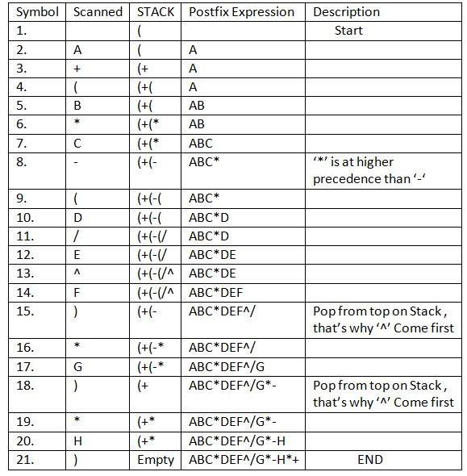
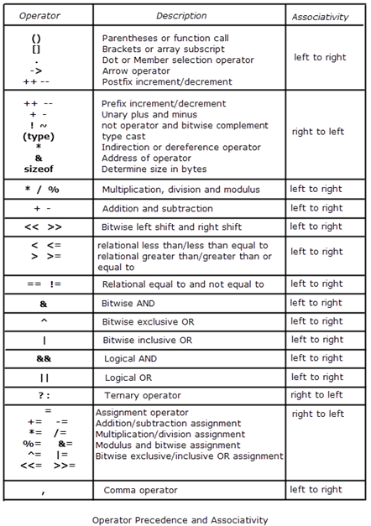
Let’s take an example to better understand the algorithm:
Infix Expression: A+ (B*C-(D/E^F)*G)*H, where ^ is an exponential operator.

Slide 26
Infix, Prefix, and Postfix are notations used for representing an expression. Each notation bears the equivalence of the same expression written in a different manner. It is fairly simple to convert from one notation to the other using stack data structure.
Introduction: Depending on the position of operators and operands, there are three types of notations or ways of writing an expression containing operators, operands, and brackets - Infix Notation, Postfix Notation, and Prefix Notation. While infix notation is easier to read for us, postfix is easier to evaluate for a machine, such as in a calculator. This is because in a postfix operation operators are evaluated from left to right in a serial manner, which eliminates the need for brackets and omits any confusion regarding operator precedence.
What is Infix Notation?
Infix notation is the notation in which operators come between the required operands. It is the same as the arithmetic notation that we had learned in our school days.
Syntax of infix notation:
The syntax of infix notation is X op Y.
Example - If we were to add two numbers 3 and 4, the operator that is '+' would come between the operands 3 and 4. So the infix notation will be 3 + 4.
Problem with infix notation
You might wonder, why do we need separate notations for writing expressions. Though infix notation is simple to read for us, it often brings with it some amount of ambiguity due to the following reasons- There are two main factors considered while evaluating an expression:
Operator precedence:
This refers to the priority given to each operator in an expression.
Associativity
If two operators have the same precedence, associativity is used to determine the order of evaluation.
The only way that infix notation tackles the above factors is through the use of parenthesis.
Thus came the need to form notations that would not hold any ambiguity, eliminate the need for operator precedence and associativity rules, and would make the parsing of expressions much simpler.

Slide 27
What is Postfix Expression?
Postfix Expression, also known as Reverse Polish Notation is the type of notation in which operator comes after the operand. For eg- If the infix expression is x + y, it's corresponding postfix notation is x y + . We will exlore in details the conversion of infix to postfix expressions.
Postfix expression is considered better than the infix expressions, as postfix expressions are easier to evaluate and also they don't have overhead of brackets.
Conversion of Infix to Postfix: It is important to know how to convert from one notation to the other. In this section we will go through the steps for converting infix to postfix. We will use a stack data structure for the above conversion. The expression we want to convert can contain operators, operands and also brackets ('('). We will consider all these while converting the expression.
Rules for the conversion from infix to postfix expression
Initially we have a infix expression given to us to convert to postfix notation. The infix notation is parsed from left to right, and then converted to postfix. Assume initially the postfix expression is empty, and we will fill the postfix expression out with the following steps:
If we have an opening parenthesis "(", we push it into the stack.
If we have an operand, we append it to our postfix expression.
If we have a closing parenthesis ")" we keep popping out elements from the top of the stack and append them to our postfix expression until we encounter an opening parenthesis. We pop out the left parenthesis without appending it.
If we encounter an operator:-
4.1. If the operator has higher precedence than the one on top of the stack (We can compare ), we push it in the stack.
4.2. If the operator has lower or equal precedence than the one on top of the stack, we keep popping out and appending it to the postfix expression.
5. When the last token of infix expression has been scanned, we pop the remaining elements from stack and append them to our postfix expression.*

Slide 28
Infix expression: K + L - M*N + (O^P) * W/U/V * T + Q
Let us dry run the above infix expression and find out its corresponding postfix expression. The above string is parsed from left to right. For each token, the elements in the stack as well as the corresponding postfix expression up to that point is shown using the table below:
Element Stack contents Postfix Expression
K K
+ +
L + K L
- - K L +
M - K L + M
* -* K L + M
N -* K L + M N
+ + K L + M N * -
( + ( K L + M N * -
O + ( ^ K L + M N * - O
^ + ( ^ K L + M N * - O
P + ( ^ K L + M N * - O P
) + K L + M N * - O P ^
* + * K L + M N* - O P ^
W + * K L + M N* - O P ^ W
/ + / K L + M N* - O P ^ W *
U + / K L + M N* - O P ^W * U
/ + / K L + M N* - O P ^W * U /
V + / K L + M N* - O P ^ W * U / V
* + * K L + M N* - O P ^W * U / V /
T + * K L + M N* - O P ^W * U / V / T
+ + K L + M N* - O P ^W * U / V / T * +
Q + K L + M N* - O P ^W * U / V / T * + Q
K L + M N* - O P ^W * U / V / T * + Q+

